Slide 1
Chapter Five
Making Connections Efficient: Multiplexing and Compression
Data Communications and Computer Networks: A Business User’s Approach
Eighth Edition
© 2016. Cengage Learning. All Rights Reserved.

Slide 2
After reading this chapter, you should be able to:
Describe frequency division multiplexing and list its applications, advantages, and disadvantages
Describe synchronous time division multiplexing and list its applications, advantages, and disadvantages
Outline the basic multiplexing characteristics of T-1 and SONET/SDH telephone systems
Describe statistical time division multiplexing and list its applications, advantages, and disadvantages
Data Communications and Computer Networks: A Business User's Approach, Eighth Edition
© 2016. Cengage Learning. All Rights Reserved.

Slide 3
After reading this chapter, you should be able to (continued):
Cite the main characteristics of wavelength division multiplexing and its advantages and disadvantages
Describe the basic characteristics of discrete multitone
Cite the main characteristics of code division multiplexing and its advantages and disadvantages
Apply a multiplexing technique to a typical business situation
Data Communications and Computer Networks: A Business User's Approach, Eighth Edition
© 2016. Cengage Learning. All Rights Reserved.

Slide 4
After reading this chapter, you should be able to (continued):
Describe the difference between lossy and lossless compression
Describe the basic operation of run-length, JPEG, and MP3 compression
Data Communications and Computer Networks: A Business User's Approach, Eighth Edition
© 2016. Cengage Learning. All Rights Reserved.

Slide 5
Introduction
Under simplest conditions, medium can carry only one signal at any moment in time
For multiple signals to share a medium, medium must somehow be divided, giving each signal a portion of the total bandwidth
Current techniques include:
  Frequency division multiplexing
  Time division multiplexing
  Code division multiplexing
Data Communications and Computer Networks: A Business User's Approach, Eighth Edition
© 2016. Cengage Learning. All Rights Reserved.

Slide 6
Frequency Division Multiplexing
Assignment of nonoverlapping frequency ranges to each “user” or signal on a medium
  Thus, all signals are transmitted at the same time, each using different frequencies
A multiplexor accepts inputs and assigns frequencies to each device
Data Communications and Computer Networks: A Business User's Approach, Eighth Edition
© 2016. Cengage Learning. All Rights Reserved.

Slide 7
Frequency Division Multiplexing (continued)
Each channel is assigned a set of frequencies and is transmitted over the medium
A corresponding multiplexor, or demultiplexor, is on the receiving end of the medium and separates the multiplexed signals
A common example is broadcast radio
Data Communications and Computer Networks: A Business User's Approach, Eighth Edition
© 2016. Cengage Learning. All Rights Reserved.

Slide 8
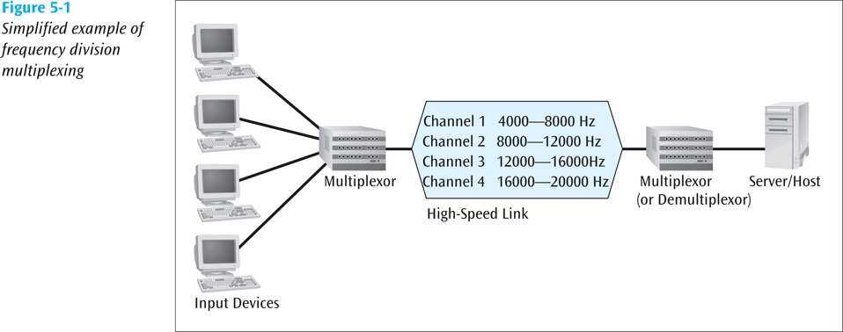
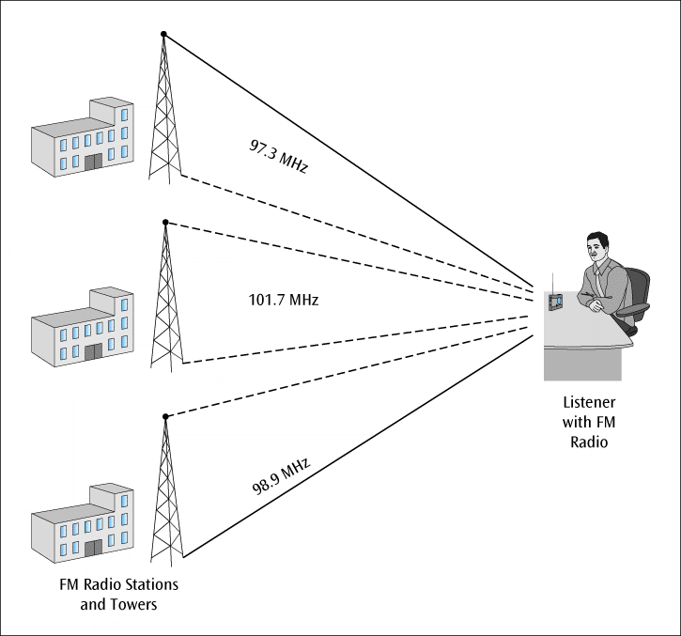
Frequency Division Multiplexing (continued)
Data Communications and Computer Networks: A Business User's Approach, Eighth Edition
© 2016. Cengage Learning. All Rights Reserved.

Slide 9
Frequency Division Multiplexing (continued)
Analog signaling is used in older systems; discrete analog signals in more recent systems
Broadcast radio and television, cable television, and cellular telephone systems use frequency division multiplexing
This technique is the oldest multiplexing technique
Since it involves a certain level of analog signaling, it may be susceptible to noise
Data Communications and Computer Networks: A Business User's Approach, Eighth Edition
© 2016. Cengage Learning. All Rights Reserved.

Slide 10
Time Division Multiplexing
Sharing of the signal is accomplished by dividing available transmission time on a medium among users
Digital signaling is used exclusively
Time division multiplexing comes in two basic forms:
  Synchronous time division multiplexing
  Statistical time division multiplexing
Data Communications and Computer Networks: A Business User's Approach, Eighth Edition
© 2016. Cengage Learning. All Rights Reserved.

Slide 11
Synchronous Time Division Multiplexing
The original time division multiplexing
The multiplexor accepts input from attached devices in a round-robin fashion and transmits the data in a never -ending pattern
T-1 and SONET telephone systems are common examples of synchronous time division multiplexing
Data Communications and Computer Networks: A Business User's Approach, Eighth Edition
© 2016. Cengage Learning. All Rights Reserved.

Slide 12
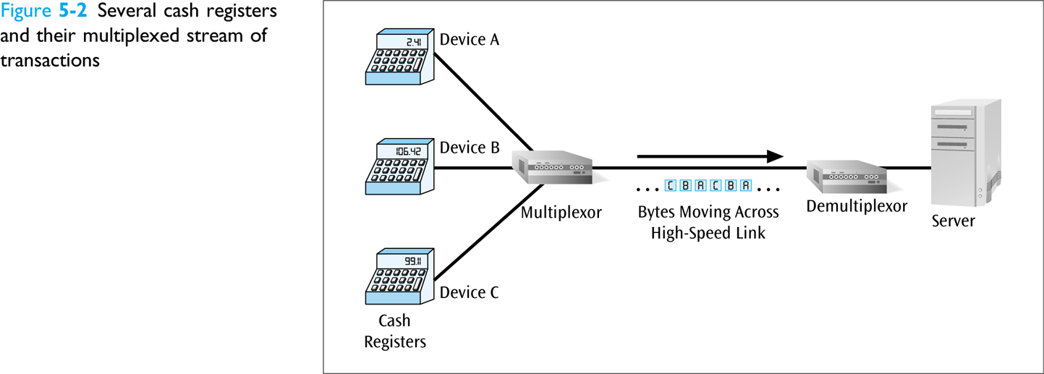
Synchronous Time Division Multiplexing (continued)
Data Communications and Computer Networks: A Business User's Approach, Eighth Edition
© 2016. Cengage Learning. All Rights Reserved.

Slide 13
Synchronous Time Division Multiplexing (continued)
If one device generates data at faster rate than other devices, then the multiplexor must either sample the incoming data stream from that device more often than it samples the other devices, or buffer the faster incoming stream
If a device has nothing to transmit, the multiplexor must still insert something into the multiplexed stream
Data Communications and Computer Networks: A Business User's Approach, Eighth Edition
© 2016. Cengage Learning. All Rights Reserved.

Slide 14
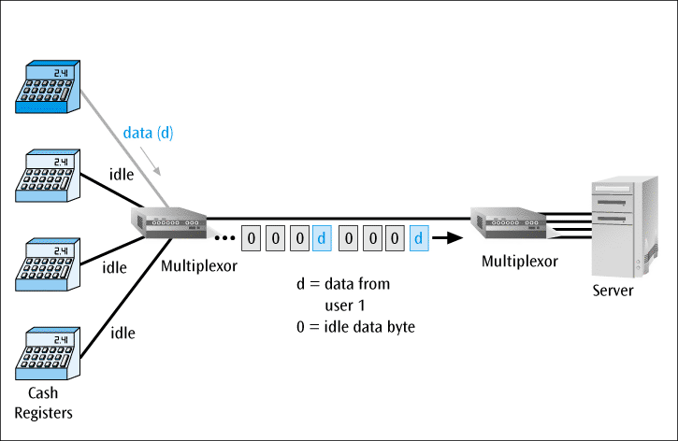
Synchronous Time Division Multiplexing (continued)
Figure 5-3
Multiplexor transmission stream with only one input device transmitting data
Data Communications and Computer Networks: A Business User's Approach, Eighth Edition
© 2016. Cengage Learning. All Rights Reserved.

Slide 15
Synchronous Time Division Multiplexing (continued)
So that the receiver may stay synchronized with the incoming data stream, the transmitting multiplexor can insert alternating 1s and 0s into the data stream
Data Communications and Computer Networks: A Business User's Approach, Eighth Edition
© 2016. Cengage Learning. All Rights Reserved.

Slide 16
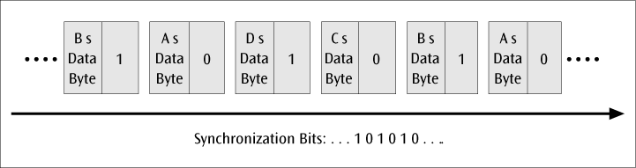
Synchronous Time Division Multiplexing (continued)
Figure 5-4
Transmitted frame with added synchroni-zation bits
Data Communications and Computer Networks: A Business User's Approach, Eighth Edition
© 2016. Cengage Learning. All Rights Reserved.

Slide 17
T-1 Multiplexing
The T-1 multiplexor stream is a continuous series of frames
Note how each frame contains the data (one byte) for potentially 24 voice-grade telephone lines, plus one sync bit
It is possible to combine all 24 channels into one channel for a total of 1.544 Mbps
Data Communications and Computer Networks: A Business User's Approach, Eighth Edition
© 2016. Cengage Learning. All Rights Reserved.

Slide 18
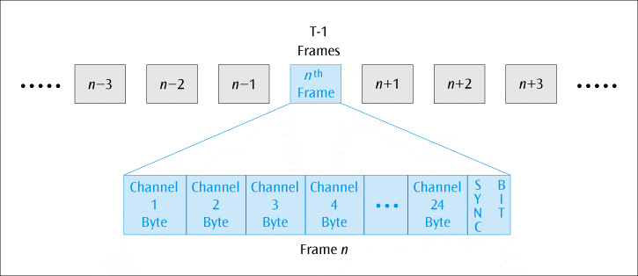
T-1 Multiplexing (continued)
Figure 5-4
T-1 multiplexed data stream
Data Communications and Computer Networks: A Business User's Approach, Eighth Edition
© 2016. Cengage Learning. All Rights Reserved.

Slide 19
SONET/SDH Multiplexing
Similar to T-1, SONET incorporates a continuous series of frames
SONET is used for high-speed data transmission
Telephone companies have traditionally used a lot of SONET but this may be giving way to other high-speed transmission services
SDH is the European equivalent to SONET
Data Communications and Computer Networks: A Business User's Approach, Eighth Edition
© 2016. Cengage Learning. All Rights Reserved.

Slide 20
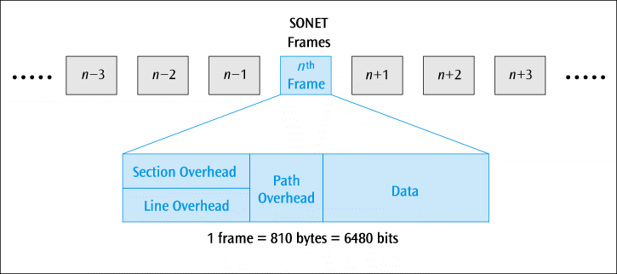
SONET/SDH Multiplexing (continued)
Figure 5-6
SONET STS-1 frame layout
Data Communications and Computer Networks: A Business User's Approach, Eighth Edition
© 2016. Cengage Learning. All Rights Reserved.

Slide 21
Statistical Time Division Multiplexing
A statistical multiplexor transmits the data from active workstations only
If a workstation is not active, no space is wasted in the multiplexed stream
Data Communications and Computer Networks: A Business User's Approach, Eighth Edition
© 2016. Cengage Learning. All Rights Reserved.

Slide 22
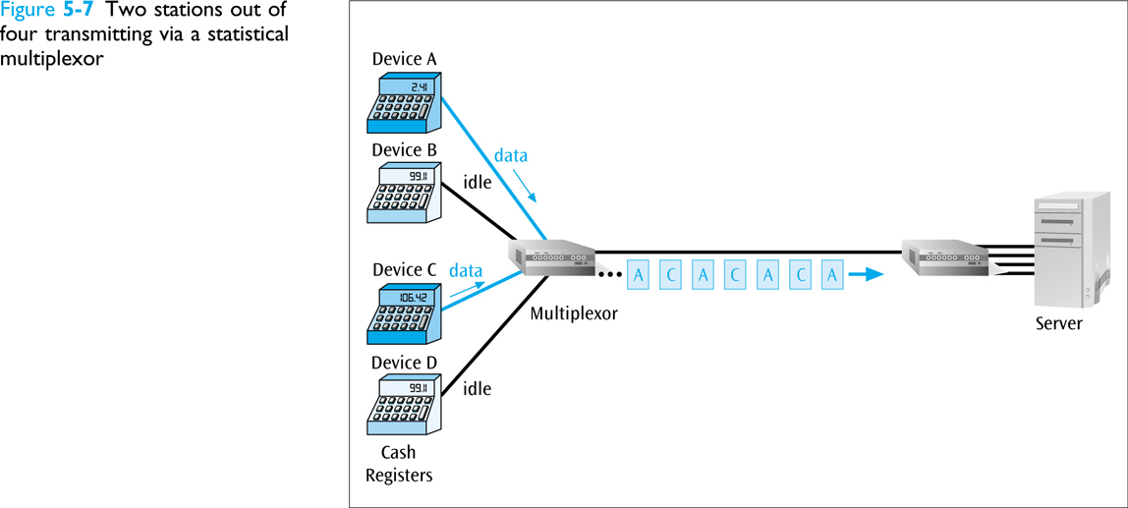
Statistical Time Division Multiplexing (continued)
Data Communications and Computer Networks: A Business User's Approach, Eighth Edition
© 2016. Cengage Learning. All Rights Reserved.

Slide 23
Statistical Time Division Multiplexing (continued)
A statistical multiplexor accepts the incoming data streams and creates a frame containing the data to be transmitted
To identify each piece of data, an address is included
Data Communications and Computer Networks: A Business User's Approach, Eighth Edition
© 2016. Cengage Learning. All Rights Reserved.

Slide 24
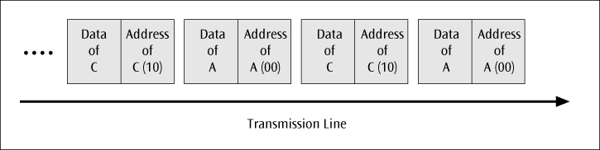
Statistical Time Division Multiplexing (continued)
Figure 5-8
Sample address and data in a statistical multiplexor output stream
Data Communications and Computer Networks: A Business User's Approach, Eighth Edition
© 2016. Cengage Learning. All Rights Reserved.

Slide 25
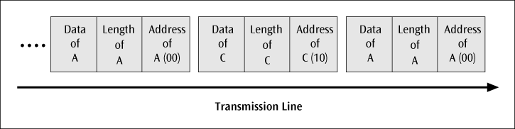
Statistical Time Division Multiplexing (continued)
If the data is of variable size, a length is also included
Figure 5-9
Packets of address, length, and data fields in a statistical multiplexor output stream
Data Communications and Computer Networks: A Business User's Approach, Eighth Edition
© 2016. Cengage Learning. All Rights Reserved.

Slide 26
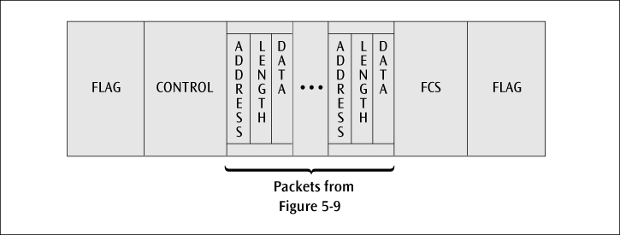
Statistical Time Division Multiplexing (continued)
More precisely, the transmitted frame contains a collection of data groups
Figure 5-10
Frame layout for the information packet transferred between statistical multiplexors
Data Communications and Computer Networks: A Business User's Approach, Eighth Edition
© 2016. Cengage Learning. All Rights Reserved.

Slide 27
Wavelength Division Multiplexing
Wavelength division multiplexing multiplexes multiple data streams onto a single fiber-optic line
Different wavelength lasers (called lambdas) transmit the multiple signals
Data Communications and Computer Networks: A Business User's Approach, Eighth Edition
© 2016. Cengage Learning. All Rights Reserved.

Slide 28
Wavelength Division Multiplexing (continued)
Each signal carried on the fiber can be transmitted at a different rate from the other signals
Dense wavelength division multiplexing combines many (30, 40, 50 or more) onto one fiber
Coarse wavelength division multiplexing combines only a few lambdas
Data Communications and Computer Networks: A Business User's Approach, Eighth Edition
© 2016. Cengage Learning. All Rights Reserved.

Slide 29
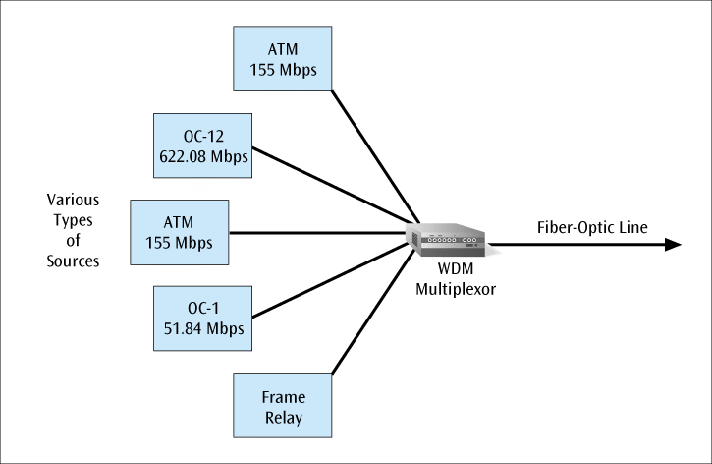
Wavelength Division Multiplexing (continued)
Figure 5-11
Fiber optic line using wavelength division multiplexing and supporting multiple- speed transmissions
Data Communications and Computer Networks: A Business User's Approach, Eighth Edition
© 2016. Cengage Learning. All Rights Reserved.

Slide 30
Discrete Multitone
Discrete Multitone (DMT) – a multiplexing technique commonly found in digital subscriber line (DSL) systems
DMT combines hundreds of different signals, or subchannels, into one stream
Interestingly, all of these subchannels belong to a single user, unlike the previous multiplexing techniques
Data Communications and Computer Networks: A Business User's Approach, Eighth Edition
© 2016. Cengage Learning. All Rights Reserved.

Slide 31
Discrete Multitone (continued)
Each subchannel is quadrature amplitude modulated (recall eight phase angles, four with double amplitudes)
Theoretically, 256 subchannels, each transmitting 60 kbps, yields 15.36 Mbps
Unfortunately, there is noise, so the subchannels back down to slower speeds
Data Communications and Computer Networks: A Business User's Approach, Eighth Edition
© 2016. Cengage Learning. All Rights Reserved.

Slide 32
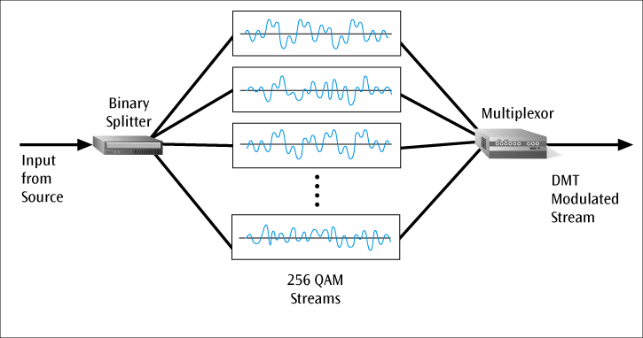
Discrete Multitone (continued)
Figure 5-12
256 quadrature amplitude modulated streams combined into one DMT signal for DSL
Data Communications and Computer Networks: A Business User's Approach, Eighth Edition
© 2016. Cengage Learning. All Rights Reserved.

Slide 33
Code Division Multiplexing
Also known as code division multiple access
An advanced technique that allows multiple devices to transmit on the same frequencies at the same time
Each mobile device is assigned a unique 64-bit code
Data Communications and Computer Networks: A Business User's Approach, Eighth Edition
© 2016. Cengage Learning. All Rights Reserved.

Slide 34
Code Division Multiplexing (continued)
To send a binary 1, a mobile device transmits the unique code
To send a binary 0, a mobile device transmits the inverse of the code
To send nothing, a mobile device transmits zeros
Data Communications and Computer Networks: A Business User's Approach, Eighth Edition
© 2016. Cengage Learning. All Rights Reserved.

Slide 35
Code Division Multiplexing (continued)
Receiver gets summed signal, multiplies it by receiver code, adds up the resulting values
  Interprets as a binary 1 if sum is near +64
  Interprets as a binary 0 if sum is near -64
Data Communications and Computer Networks: A Business User's Approach, Eighth Edition
© 2016. Cengage Learning. All Rights Reserved.

Slide 36
Code Division Multiplexing (continued)
For simplicity, assume 8-bit code
Example
  Three different mobile devices use the following codes:
    Mobile A: 11110000
    Mobile B: 10101010
    Mobile C: 00110011
  Assume Mobile A sends a 1, B sends a 0, and C sends a 1
  Signal code: 1-chip = +N volt; 0-chip = -N volt
Data Communications and Computer Networks: A Business User's Approach, Eighth Edition
© 2016. Cengage Learning. All Rights Reserved.

Slide 37
Code Division Multiplexing (continued)
Example (continued)
  Three signals transmitted:
    Mobile A sends a 1, or 11110000, or ++++----
    Mobile B sends a 0, or 01010101, or -+-+-+-+
    Mobile C sends a 1, or 00110011, or --++--++
  Summed signal received by base station: -1, +1, +1, +3, -3, -1, -1, +1
Data Communications and Computer Networks: A Business User's Approach, Eighth Edition
© 2016. Cengage Learning. All Rights Reserved.

Slide 38
Code Division Multiplexing (continued)
Example (continued)
  Base station decode for Mobile A:
    Signal received: -1, +1, +1, +3, -3, -1, -1, +1
    Mobile A’s code: +1, +1, +1, +1, -1, -1, -1, -1
    Product result: -1, +1, +1, +3, +3, +1, +1, -1
  Sum of Products: +8
  Decode rule: For result near +8, data is binary 1
Data Communications and Computer Networks: A Business User's Approach, Eighth Edition
© 2016. Cengage Learning. All Rights Reserved.

Slide 39
Code Division Multiplexing (continued)
Example (continued)
  Base station decode for Mobile B:
    Signal received: -1, +1, +1, +3, -3, -1, -1, +1
    Mobile B’s code: +1, -1, +1, -1, +1, -1, +1, -1
    Product result: -1, -1, +1, -3, -3, +1, -1, -1
  Sum of Products: -8
  Decode rule: For result near -8, data is binary 0
Data Communications and Computer Networks: A Business User's Approach, Eighth Edition
© 2016. Cengage Learning. All Rights Reserved.

Slide 40
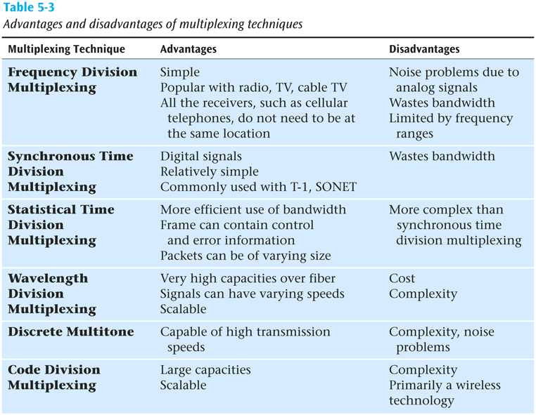
Comparison of Multiplexing Techniques
Data Communications and Computer Networks: A Business User's Approach, Eighth Edition
© 2016. Cengage Learning. All Rights Reserved.

Slide 41
Compression–Lossless versus Lossy
Compression is another technique used to squeeze more data over a communications line or into a storage space
  If you can compress a data file down to one half of its original size, the file will obviously transfer in less time
Two basic groups of compression:
  Lossless – when data is uncompressed, original data returns
  Lossy – when data is uncompressed, you do not have the original data
Data Communications and Computer Networks: A Business User's Approach, Eighth Edition
© 2016. Cengage Learning. All Rights Reserved.

Slide 42
Compression–Lossless versus Lossy (continued)
Compress a financial file?
  You want lossless
Compress a video image, movie, or audio file?
  Lossy is OK
Examples of lossless compression include:
  Huffman codes, run-length compression, Lempel-Ziv compression, and FLAC
Examples of lossy compression include:
  MPEG, JPEG, and MP3
Data Communications and Computer Networks: A Business User's Approach, Eighth Edition
© 2016. Cengage Learning. All Rights Reserved.

Slide 43
Lossless Compression
Run-length encoding
  Replaces runs of 0s with a count of how many 0s.
00000000000000100000000011000000000000000000001…11000000000001
      ^
      (30 0s)
  14 9 0 20 30 0 11
Data Communications and Computer Networks: A Business User's Approach, Eighth Edition
© 2016. Cengage Learning. All Rights Reserved.

Slide 44
Lossless Compression (continued)
Run-length encoding (continued)
  Now replace each decimal value with a 4-bit binary value (nibble)
    Note: If you need to code a value larger than 15, you need to use two consecutive 4-bit nibbles
      The first is decimal 15, or binary 1111, and the second nibble is the remainder
        For example, if the decimal value is 20, you would code 1111 0101 which is equivalent to 15 + 5
Data Communications and Computer Networks: A Business User's Approach, Eighth Edition
© 2016. Cengage Learning. All Rights Reserved.

Slide 45
Lossless Compression (continued)
Run-length encoding (continued)
  If you want to code the value 15, you still need two nibbles: 1111 0000
    The rule is that if you ever have a nibble of 1111, you must follow it with another nibble
Data Communications and Computer Networks: A Business User's Approach, Eighth Edition
© 2016. Cengage Learning. All Rights Reserved.

Slide 46
Lossy Compression
Audio and video files do not compress well using lossless techniques
And we can take advantage of the fact that the human ear and eye can be tricked into hearing and seeing things that aren’t really there
So let’s use lossy compression techniques on audio and video (just as long as we don’t lose too much of the audio or video!)
Data Communications and Computer Networks: A Business User's Approach, Eighth Edition
© 2016. Cengage Learning. All Rights Reserved.

Slide 47
Audio Compression
Much audio is now compressed - MP3 players found in cell phones and iPod-like devices store and play compressed music
Audio compression is tricky and hard to describe. For example, a louder sound may mask a softer sound when both played together (so drop the softer sound)
Some people don’t like compressed audio and prefer to store their music in uncompressed form (such as FLAC), but this takes more storage
Data Communications and Computer Networks: A Business User's Approach, Eighth Edition
© 2016. Cengage Learning. All Rights Reserved.

Slide 48
Video Compression
Video (both still images and moving video) does not compress well using run-length encoding
  When examining the pixel values in an image, not many are alike
But what about from frame to frame within a moving video?
  The difference between video frames is usually very small
  So what if we just sent the difference between frames?
Data Communications and Computer Networks: A Business User's Approach, Eighth Edition
© 2016. Cengage Learning. All Rights Reserved.

Slide 49
Video Compression (continued)
5 7 6 2 8 6 6 3 5 6
6 5 7 5 5 6 3 2 4 7
8 4 6 8 5 6 4 8 8 5
5 1 2 9 8 6 5 5 6 6
First Frame
5 7 6 2 8 6 6 3 5 6
6 5 7 6 5 6 3 2 3 7
8 4 6 8 5 6 4 8 8 5
5 1 3 9 8 6 5 5 7 6
Second Frame
0 0 0 0 0 0 0 0 0 0
0 0 0 1 0 0 0 0 -1 0
0 0 0 0 0 0 0 0 0 0
0 0 1 0 0 0 0 0 1 0
Difference
Data Communications and Computer Networks: A Business User's Approach, Eighth Edition
© 2016. Cengage Learning. All Rights Reserved.

Slide 50
MPEG
MPEG (Motion Picture Experts Group) is a group of people that have created a set of standards that can use these small differences between frames to compress a moving video (and audio) to a fraction of its original size
Data Communications and Computer Networks: A Business User's Approach, Eighth Edition
© 2016. Cengage Learning. All Rights Reserved.

Slide 51
Image Compression
What about individual images?
For example, a color image can be defined by red/green/blue, or luminance/chrominance/ chrominance, which are based on RGB values (Red, Green, Blue)
If you have three color values and each is 8 bits, you have 24 bits total (or 2²⁴ colors!)
Data Communications and Computer Networks: A Business User's Approach, Eighth Edition
© 2016. Cengage Learning. All Rights Reserved.

Slide 52
Image Compression (continued)
Consider a VGA screen is 640 x 480 pixels
  24 bits x 640 x 480 = 7,372,800 bits – Ouch!
  We need compression!
Data Communications and Computer Networks: A Business User's Approach, Eighth Edition
© 2016. Cengage Learning. All Rights Reserved.

Slide 53
Image Compression (continued)
JPEG (Joint Photographic Experts Group)
  Compresses still images
  Lossy
  JPEG compression consists of 3 phases:
    Discrete cosine transformations (DCT)
    Quantization
    Run-length encoding
Data Communications and Computer Networks: A Business User's Approach, Eighth Edition
© 2016. Cengage Learning. All Rights Reserved.

Slide 54
JPEG (continued)
JPEG Step 1 – DCT
  Divide image into a series of 8x8 pixel blocks
  If the original image was 640x480 pixels, the new picture would be 80 blocks x 60 blocks (next slide)
  If B&W, each pixel in 8x8 block is an 8-bit value (0-255)
  If color, each pixel is a 24-bit value (8 bits for red, 8 bits for blue, and 8 bits for green)
Data Communications and Computer Networks: A Business User's Approach, Eighth Edition
© 2016. Cengage Learning. All Rights Reserved.

Slide 55
JPEG (continued)
80 blocks
60 blocks
640 x 480 VGA Screen Image
Divided into 8 x 8 Pixel Blocks
Data Communications and Computer Networks: A Business User's Approach, Eighth Edition
© 2016. Cengage Learning. All Rights Reserved.

Slide 56
JPEG (continued)
JPEG Step 1 – DCT (continued)
  So what does DCT do?
    Takes an 8x8 matrix (P) and produces a new 8x8 matrix (T) using cosines
    T matrix contains a collection of values called spatial frequencies
    These spatial frequencies relate directly to how much the pixel values change as a function of their positions in the block
Data Communications and Computer Networks: A Business User's Approach, Eighth Edition
© 2016. Cengage Learning. All Rights Reserved.

Slide 57
JPEG (continued)
JPEG Step 1 – DCT (continued)
  An image with uniform color changes (little fine detail) has a P matrix with closely similar values and a corresponding T matrix with many zero values
  An image with large color changes over a small area (lots of fine detail) has a P matrix with widely changing values, and thus a T matrix with many non-zero values (as shown on next slide)
Data Communications and Computer Networks: A Business User's Approach, Seventh Edition

Slide 58
120 | 80 | 110 | 65 | 90 | 142 | 56 | 100
40 | 136 | 93 | 188 | 90 | 210 | 220 | 56
95 | 89 | 134 | 74 | 170 | 180 | 45 | 100
9 | 110 | 145 | 93 | 221 | 194 | 83 | 110
65 | 202 | 90 | 18 | 164 | 90 | 155 | 43
93 | 111 | 39 | 221 | 33 | 37 | 40 | 129
55 | 122 | 52 | 166 | 93 | 54 | 13 | 100
29 | 92 | 153 | 197 | 84 | 197 | 83 | 83
Original pixel
values (P matrix)
652 | 32 | -40 | 54 | -18 | 129 | -33 | 84
111 | -33 | 53 | 9 | 123 | -43 | 65 | 100
-22 | 101 | 94 | -32 | 23 | 104 | 76 | 101
88 | 33 | 211 | 2 | -32 | 143 | 43 | 14
132 | -32 | 43 | 0 | 122 | -48 | 54 | 110
54 | 11 | 133 | 27 | 56 | 154 | 13 | -94
-54 | -69 | 10 | 109 | 65 | 0 | 17 | -33
199 | -18 | 99 | 98 | 22 | -43 | 8 | 32
Values (T matrix)
after the cosine
transformation
has been
applied (note
larger values in
upper-left)

Slide 59
JPEG (continued)
JPEG Step 2 -Quantization
  The human eye can’t see small differences in color
  So take T matrix and divide all values by 10
    Will give us more zero entries
      More 0s means more compression!
    But this is too lossy
    And dividing all values by 10 doesn’t take into account that upper left of matrix has more weight
    So divide T matrix by a matrix like the following:
Data Communications and Computer Networks: A Business User's Approach, Eighth Edition
© 2016. Cengage Learning. All Rights Reserved.

Slide 60
JPEG (continued)
1 | 4 | 7 | 10 | 13 | 16 | 19 | 22
4 | 7 | 10 | 13 | 16 | 19 | 22 | 25
7 | 10 | 13 | 16 | 19 | 22 | 25 | 28
10 | 13 | 16 | 19 | 22 | 25 | 28 | 31
13 | 16 | 19 | 22 | 25 | 28 | 31 | 33
16 | 19 | 22 | 25 | 28 | 31 | 33 | 36
19 | 22 | 25 | 28 | 31 | 34 | 37 | 40
22 | 25 | 28 | 31 | 34 | 37 | 40 | 43
If we divide the T matrix by the above matrix,
we might get something like the next slide:
Data Communications and Computer Networks: A Business User's Approach, Eighth Edition
© 2016. Cengage Learning. All Rights Reserved.

Slide 61
JPEG (continued)
652 | 8 | -5 | 5 | -1 | 8 | 0 | 3
27 | -4 | 5 | 0 | 7 | -2 | 2 | 4
-3 | 10 | 7 | 2 | 1 | 4 | 3 | 3
8 | 2 | 13 | 0 | -1 | 5 | 1 | 0
10 | -2 | 2 | 0 | 4 | -1 | 1 | 3
3 | 0 | 6 | 1 | 2 | 4 | 0 | -2
-2 | -3 | 0 | 3 | 2 | 0 | 0 | 0
9 | 0 | 3 | 3 | 0 | -1 | 0 | 0
The resulting matrix Q after cosine
transformation and quantization
Data Communications and Computer Networks: A Business User's Approach, Eighth Edition
© 2016. Cengage Learning. All Rights Reserved.

Slide 62
JPEG (continued)
JPEG Step 3 – Run-length encoding
  Now take the quantized matrix Q and perform run-length encoding on it
    But don’t just go across the rows
      Longer runs of zeros if you perform the run-length encoding in a diagonal fashion
Data Communications and Computer Networks: A Business User's Approach, Eighth Edition
© 2016. Cengage Learning. All Rights Reserved.

Slide 63
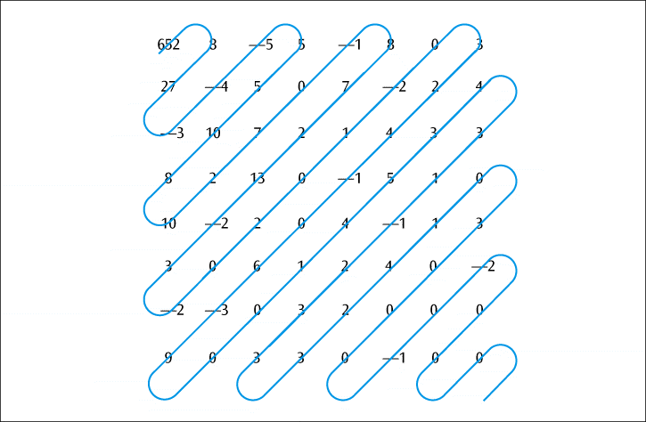
JPEG (continued)
Figure 5-13
Run-length encoding of a JPEG image
Data Communications and Computer Networks: A Business User's Approach, Eighth Edition
© 2016. Cengage Learning. All Rights Reserved.

Slide 64
JPEG (continued)
How do you get the image back?
  Undo run-length encoding
  Multiply matrix Q by matrix U yielding matrix T
  Apply similar cosine calculations to get original P matrix back
Data Communications and Computer Networks: A Business User's Approach, Eighth Edition
© 2016. Cengage Learning. All Rights Reserved.

Slide 65
Business Multiplexing In Action
Bill’s Market has 10 cash registers at the front of their store
Bill wants to connect all cash registers together to collect data transactions
List some efficient techniques to link the cash registers
Data Communications and Computer Networks: A Business User's Approach, Eighth Edition
© 2016. Cengage Learning. All Rights Reserved.

Slide 66
Business Multiplexing In Action (continued)
Possible solutions
  Connect each cash register to a server using point-to-point lines
  Transmit the signal of each cash register to a server using wireless transmissions
  Combine all the cash register outputs using multiplexing, and send the multiplexed signal over a conducted-medium line
Data Communications and Computer Networks: A Business User's Approach, Eighth Edition
© 2016. Cengage Learning. All Rights Reserved.

Slide 67
Summary
For multiple signals to share a single medium, the medium must be divided into multiple channels
Frequency division multiplexing involves assigning nonoverlapping frequency ranges to different signals
  Uses analog signals
Time division multiplexing of a medium involves dividing the available transmission time on a medium among the users
  Uses digital signals
Data Communications and Computer Networks: A Business User's Approach, Eighth Edition
© 2016. Cengage Learning. All Rights Reserved.

Slide 68
Summary (continued)
Synchronous time division multiplexing accepts input from a fixed number of devices and transmits their data in an unending repetitious pattern
Statistical time division multiplexing accepts input from a set of devices that have data to transmit, creates a frame with data and control information, and transmits that frame
Wavelength division multiplexing involves fiber-optic systems and the transfer of multiple streams of data over a single fiber using multiple, colored laser transmitters
Discrete multitone is a technology used in DSL systems
Data Communications and Computer Networks: A Business User's Approach, Eighth Edition
© 2016. Cengage Learning. All Rights Reserved.

Slide 69
Summary (continued)
Code division multiplexing allows multiple users to share the same set of frequencies by assigning a unique digital code to each user
Compression is a process that compacts data into a smaller package
Two basic forms of compression exist: lossless and lossy
Two popular forms of lossless compression include run-length encoding and the Lempel-Ziv compression technique
Lossy compression is the basis of a number of compression techniques
Data Communications and Computer Networks: A Business User's Approach, Eighth Edition
© 2016. Cengage Learning. All Rights Reserved.

